Slide 1

Kill Mo’ Chicken
Team 5 Guys

Slide 2
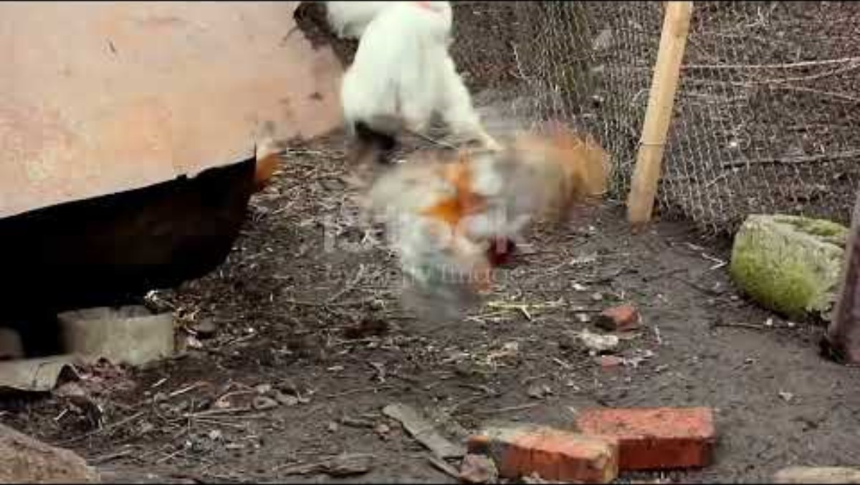
Notes:
In a world where farmyard alliances hang by a thread, a battle rages between two unlikely foes: the noble cows and the cunning chickens. This tower defense game unfolds in the lush fields of Pastoria, where the serene life of grazing and pecking is shattered by an insatiable hunger for survival. As the sun rises over the golden pastures, the cows gather for a council. Once content to roam freely, they face a grim reality: their numbers dwindle while the appetite for chicken falls. A desperate plan emerges—convince the human population to indulge in more chicken, hoping to divert the threat from their own kind. But the crafty chickens, realizing their impending doom, rally together, determined to defend their place on the dinner plate. Players are thrust into this conflict, commanding the courageous cows who must build defenses, create strategic formations, and utilize an arsenal of dairy-inspired weaponry. From fortified barns to mooo-tary towers that unleash milk grenades, the cows will stop at nothing to spread their message: "Eat more chicken!" Yet, the chickens, equipped with feathered tactics and relentless speed, retaliate with their own arsenal—egg bombs and clucky distractions—to thwart the cows' efforts. The stakes are high as players navigate the intricate balance between defense and persuasion, setting up traps and upgrading their defenses while trying to sway the humans to their cause. As waves of chickens charge, players must strategize, adapt, and fight to protect their bovine brethren. Will the cows succeed in their mission to shift the tides of culinary preference, or will the chickens rise triumphant, defending their legacy from the clutches of the dinner table? The fate of Pastoria hangs in the balance, and only the boldest will prevail in this epic clash of clucks and moo

Slide 3

Storyboard

Slide 4
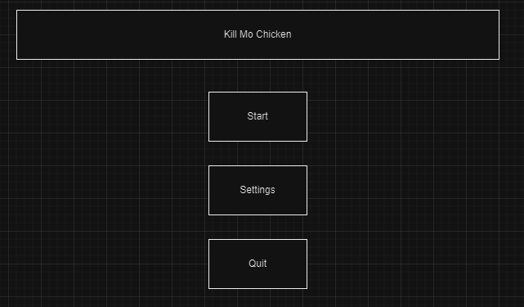
Start Menu
Upon Opening the game, the user will be able to choose from 3 options, Start, Settings, and Quit

Slide 5
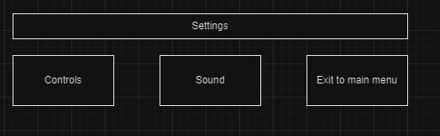
Settings Menu
In the menu screen, the user is prompted with a settings button, this menu will allow the user to understand the controls and change the music settings

Slide 6
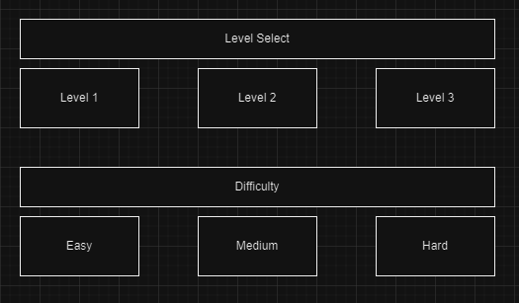
Level Selector
The user will be prompted with levels that they are able to choose from, and the difficulty they want.

Slide 7
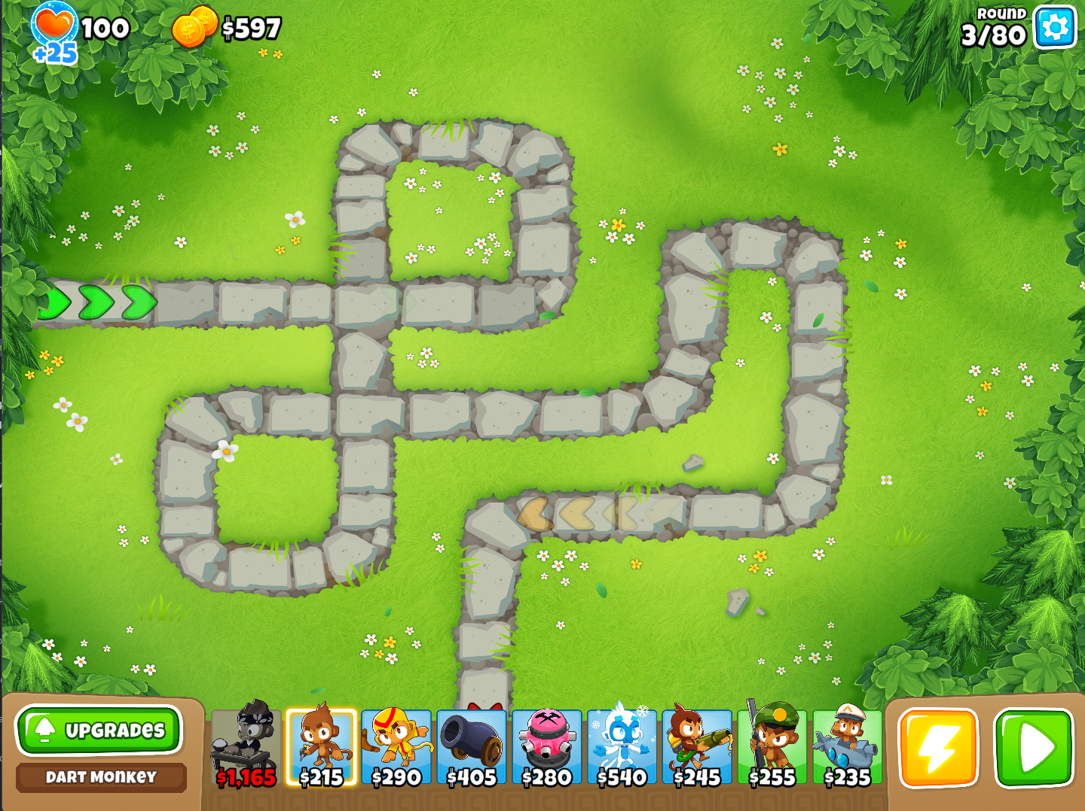
Map and UI
Upon loading into the game the player is presented with a map. In the image you can see a path, player health, currency(to buy towers), a way to pause the game, and a way to select towers.
(Source: BTD 6)

Slide 8
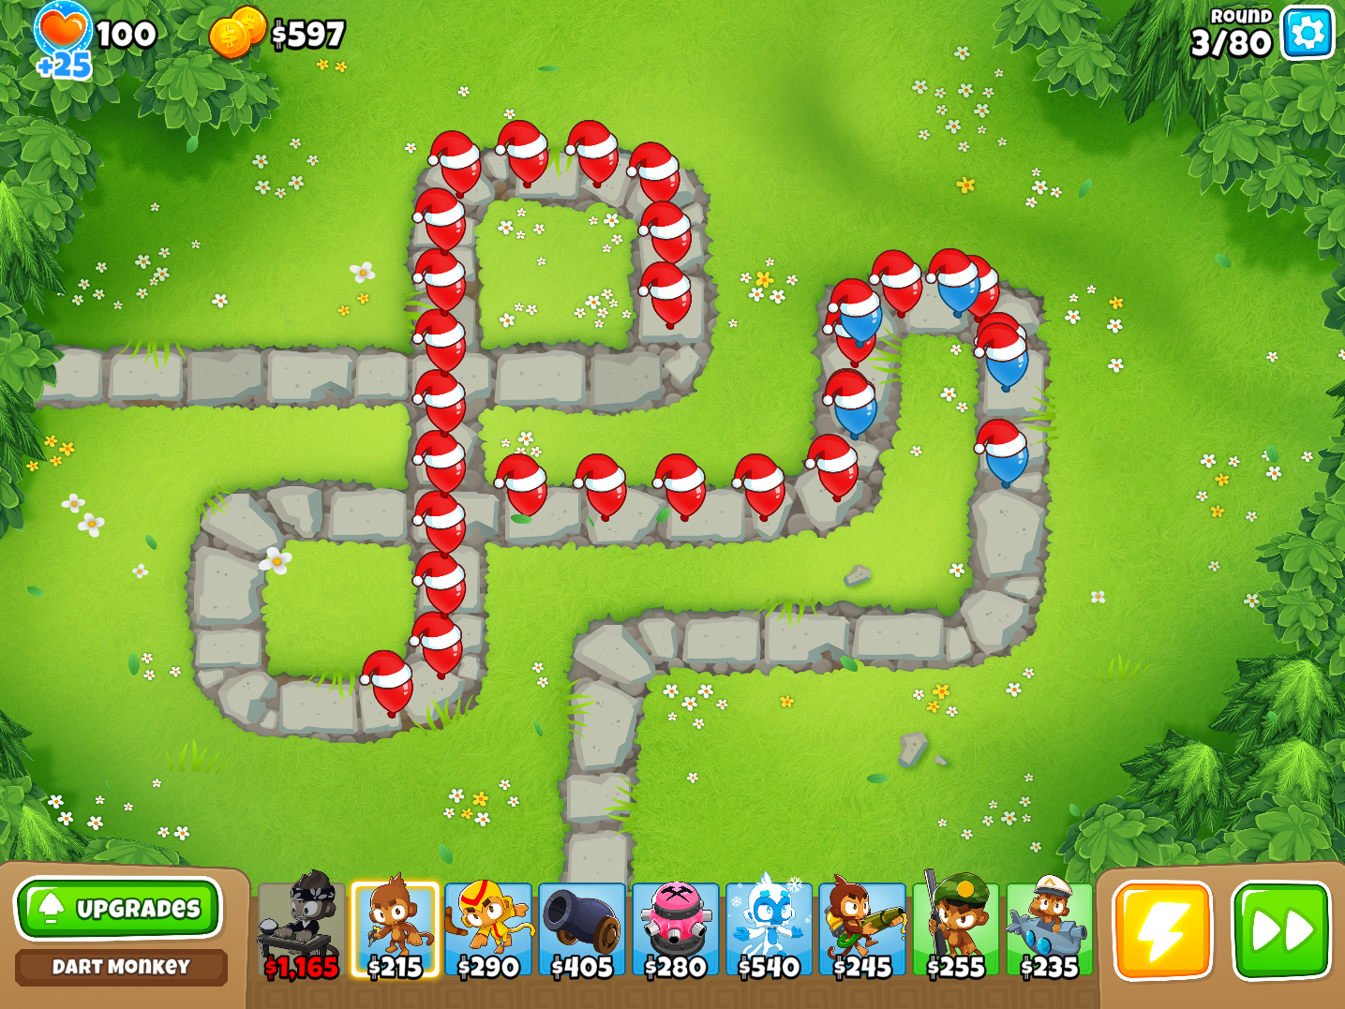
Enemy pathing
When the game is started, the enemy will begin to move along the designated path. Notice that the different enemy tiers move at different speeds along the path.
(Source: BTD 6)

Slide 9
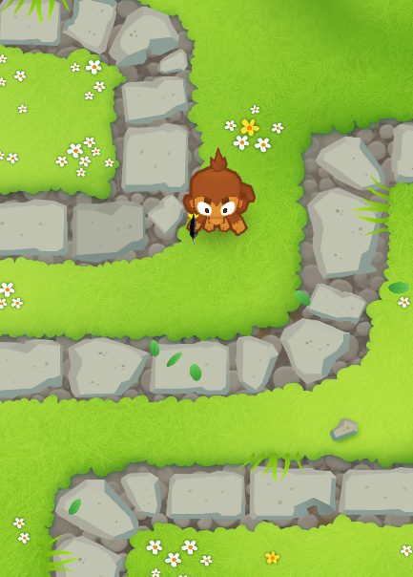
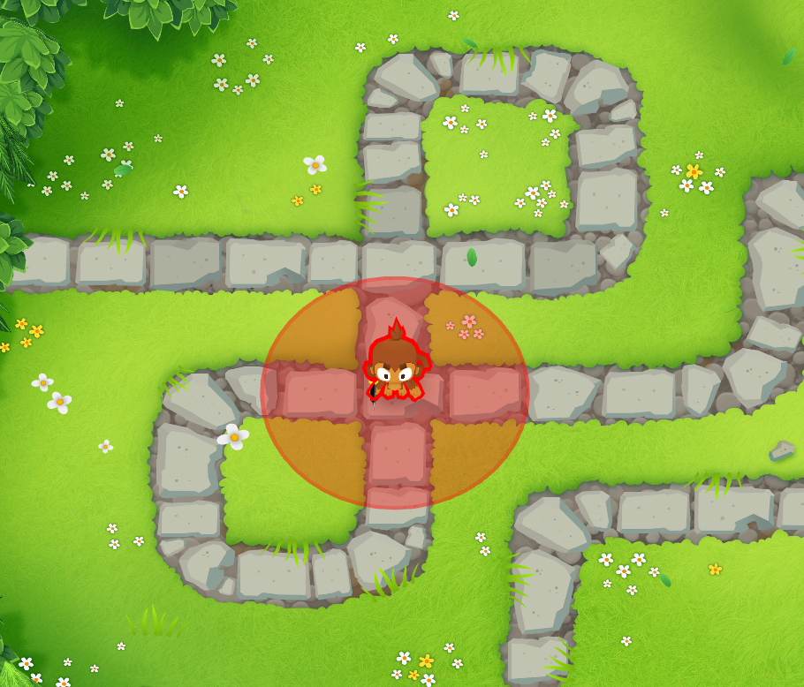
Tower Placement
For tower placement, the player will not be allowed to put the towers on the path of the balloon, but will be allowed to place them anywhere else.
Note: each tower will have a certain range they can attack within
(Source: BTD 6)

Slide 10
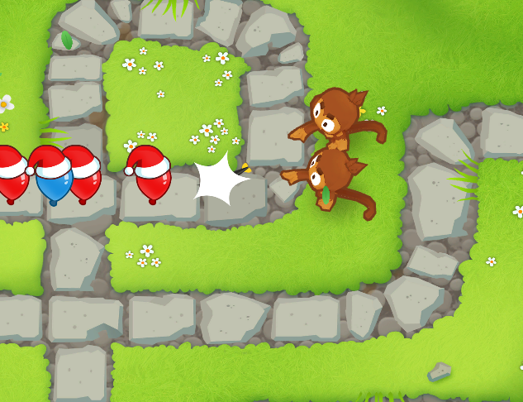
Defeating enemies
When enemies get within range of the towers, they attack the enemies, and when they reach 0 health they are eliminated and disappear from screen no longer posing a threat.
(Source: BTD 6)

Slide 11
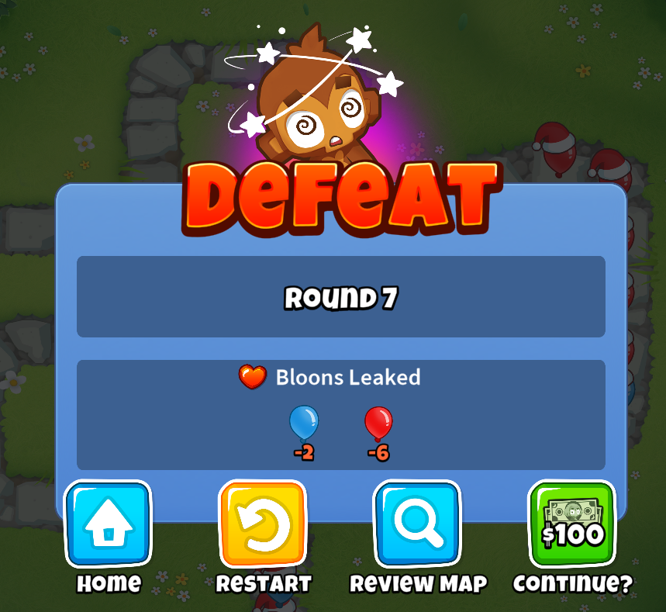

Losing / winning
When the player loses, they are faced with a screen allowing options for main menu, and restart. (The features we will be using) The other image refers to the round that would need to be completed to beat the level, and the icon for in game settings.
(Source: BTD 6)

Slide 12
Global Use Case

Slide 13
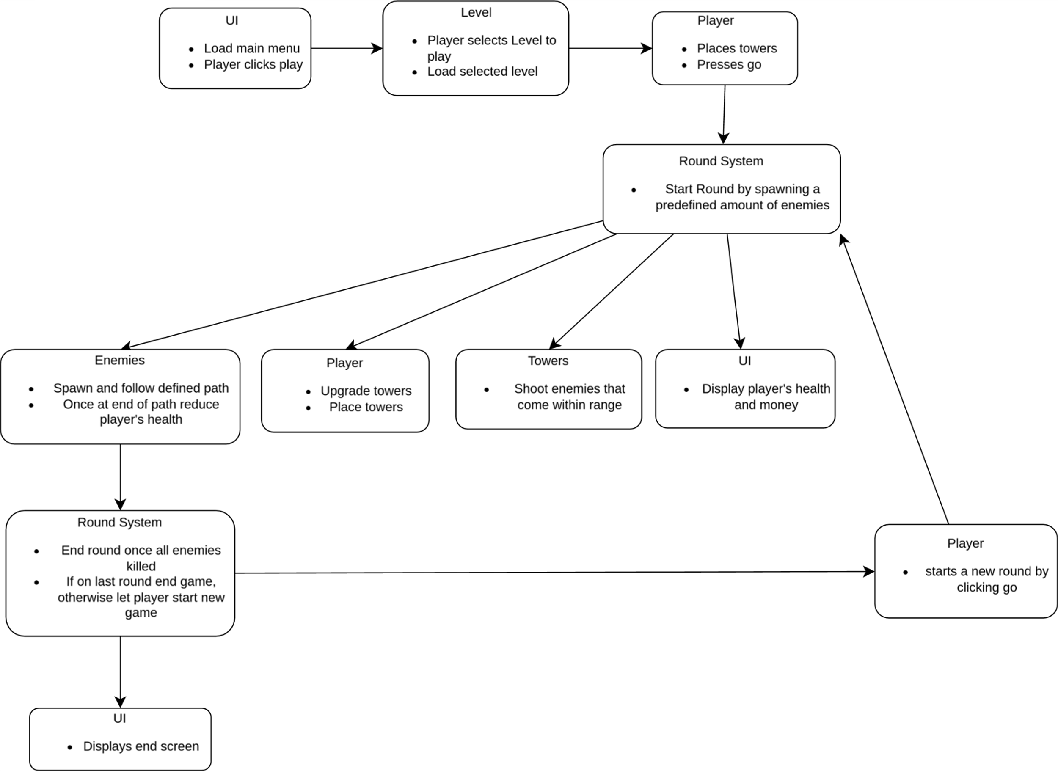

Slide 14
Project Details

Slide 15
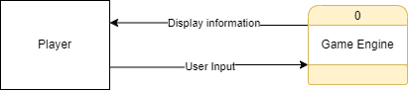
Context Diagram

Slide 16
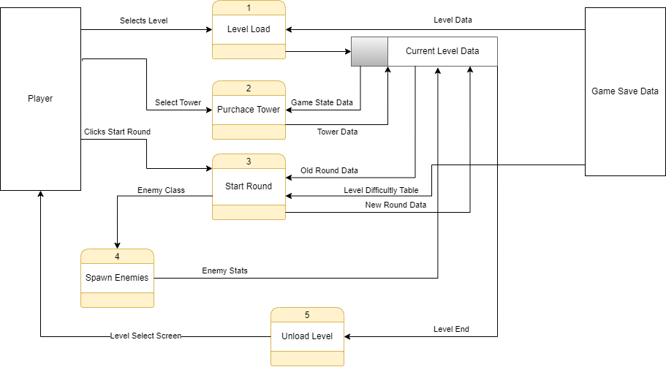
Diagram 0

Slide 17
Levels
Austin TL2

Slide 18
Overview
Level Design
Level Assets
Tower Placement Zones
Priority: High
Complexity: Low
Austin TL2

Slide 19
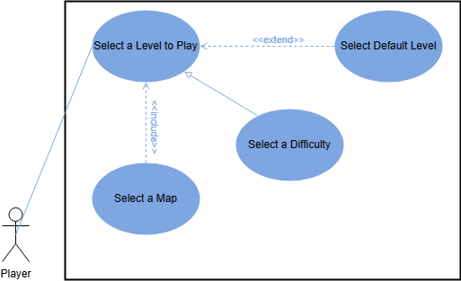
Use Case
Austin TL2

Slide 20
Main Menu/UI
Sohan

Slide 22
Round Manager
Nathan Hampton

Slide 23
Round Manager
When a Level is loaded and the user wants to start the round, the round manager needs to
Track the round difficultly
Add enemies to the spawning queue in the level
Keep track of when the round is complete.
Increase the difficulty based on how many rounds have passed
Let the UI system know when a round is done.
Signal to the UI system if the player has completed all the rounds, or if the player has died.
Priority: Critical
Complexity: Medum complexity
Nathan Hampton

Slide 24
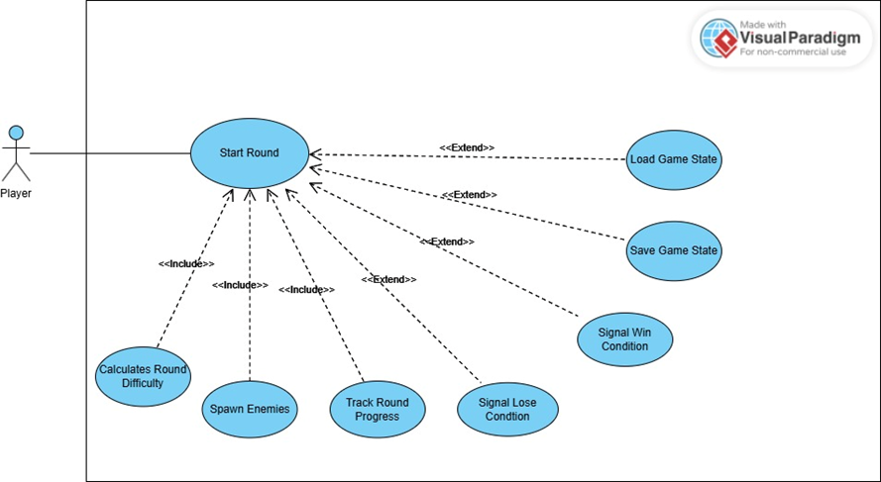
Round Manager
When a Level is loaded and the user wants to start the round, the round manager needs to
Track the round difficultly
Add enemies to the spawning queue in the level
Keep track of when the round is complete.
Increase the difficulty based on how many rounds have passed
Let the UI system know when a round is done.
Signal to the UI system if the player has completed all the rounds, or if the player has died.
Nathan Hampton

Slide 25
Enemies
Clayton

Slide 26
Overview
Enemy Health
Enemy Damage
Enemy Pathing
"Chicken Split"
Chicken Spawn as extension
Clayton Slack TL5

Slide 27
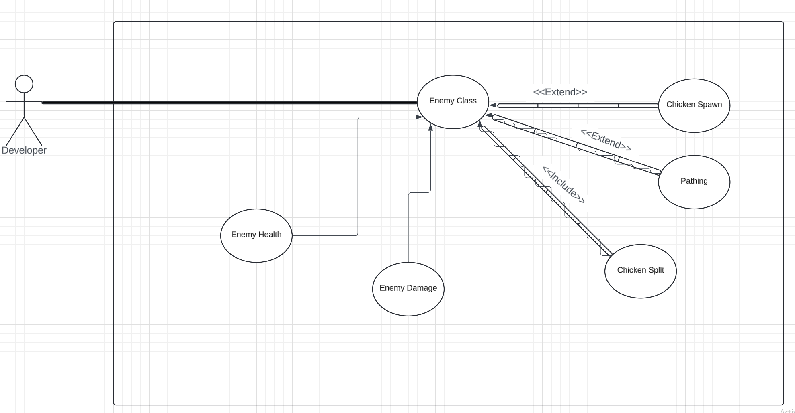
Use Case
Clayton Slack TL5

Slide 28
Priority and Complexity
Priority: High
Being a main game feature, the enemy class is needed for the game to function at all
Complexity level: High Medium
Assigning Health and damage to an entity is relatively straight forward, pathing and "Chicken Split" will be harder to implement, however are a part of the Godot Game Engine.
Clayton Slack TL5

Slide 29
Towers
Ankit

